Slide 1
Group Project
Algonquin College Room Finder
Group Members: Yi and Meghna

Slide 2
Introduction of Project:
Algonquin College Room Finder is about finding the right location. It helps everyone to find room, building and parking lots.
This app has different functionalities like student can search outdoor and indoor maps.
Our app is user friendly and user can run it easily

Slide 3
User Research
During Research we talked to different students, help desk workers and visitors as well. We got the following points during research:
Students, visitors and new teachers they don’t understand the Algonquin College Map.
There is no other way for them without asking someone to get the right place.
They were asking the help desk workers to get to the location

Slide 4
Personas
In this project there are four person who are representing different situations.
Jiana new Algonquin student
20 years, from Spain and taking computer engineering program in Algonquin College
Jagdish Information Desk Worker
24 years, from India and help students to find locations
Bob Visitor
50years, Canadian and runs software company JKS technologies

Slide 5
Scenarios Four different scenarios for our project:
Jiana’ s way from baseline to class
Jiana’s fastest way from baseline to class
Jagdish is helping students by explaining directions
Bob’s first visit in Algonquin College

Slide 6

Persona: Jiana Algonquin new student (primary)
Goals and Attitudes:
Wants to find correct location on time
Wants to find the an fastest indoor route to get the class when weather is bad
Find out how long it will take to get from one class to the baseline station
Skills and Knowledge:
Speaks English, Spanish
Uses technology to solve problems
Experienced in using Google map on phone
Good in finding locations
Context of use:
On the first day of college she felt nervous about new environment, now she is bit comfortable
Checks Algonquin website maps before she arrives on campus
Uses maps on her phone to learn more about campus
Uses 3G connection to get the directions
Uses HTC one phone
Tasks:
Uses app to find a room in Algonquin
See online map of Algonquin college
Before leaving home , she calculate the best direction for her, when she has multiple choices
Follow the steps given by app such as what is the next step , when she arrives a intersection
“I want to reach my classroom on time”
Description：
Age: 20
Name: Jiana
Student: Algonquin College
Nationality : Spain
Program : Computer Engineering
Motivation：High
First year Student
Have HTC one smart phone
Takes public transportation

Slide 7
Usage Scenario: Jiana’s way from baseline to class (primary)
Tasks
Jiana takes out her phone and launches the app
The app automatically recognizes that she is standing at Baseline station.
She enters the building and room number that she wants to find
The app gives two option to her, “indoor” and “outdoor”, and she choose indoor.
App illustrates a campus map and a blue route to show her how to get P105
room.
She looks her phone how long it will take to get to her class
She decides to look at “list all steps”.
In this list, app directly tells her turn right or left by using her currently geo-location, so she finally find P105 room on time.
Context of use
Takes public transportation to get to the college.
Uses an HTC One phone with a 3G connection to launch app.
Its raining, she used indoor maps to get to class.
She is holding an umbrella in one hand
Description
Jiana is new Algonquin student .
She wants to find out how to get to her class on the second day on time. She is currently at Baseline station and decides to use an app to find her classroom, P105 room. Its raining , so she wants an indoor route.

Slide 8
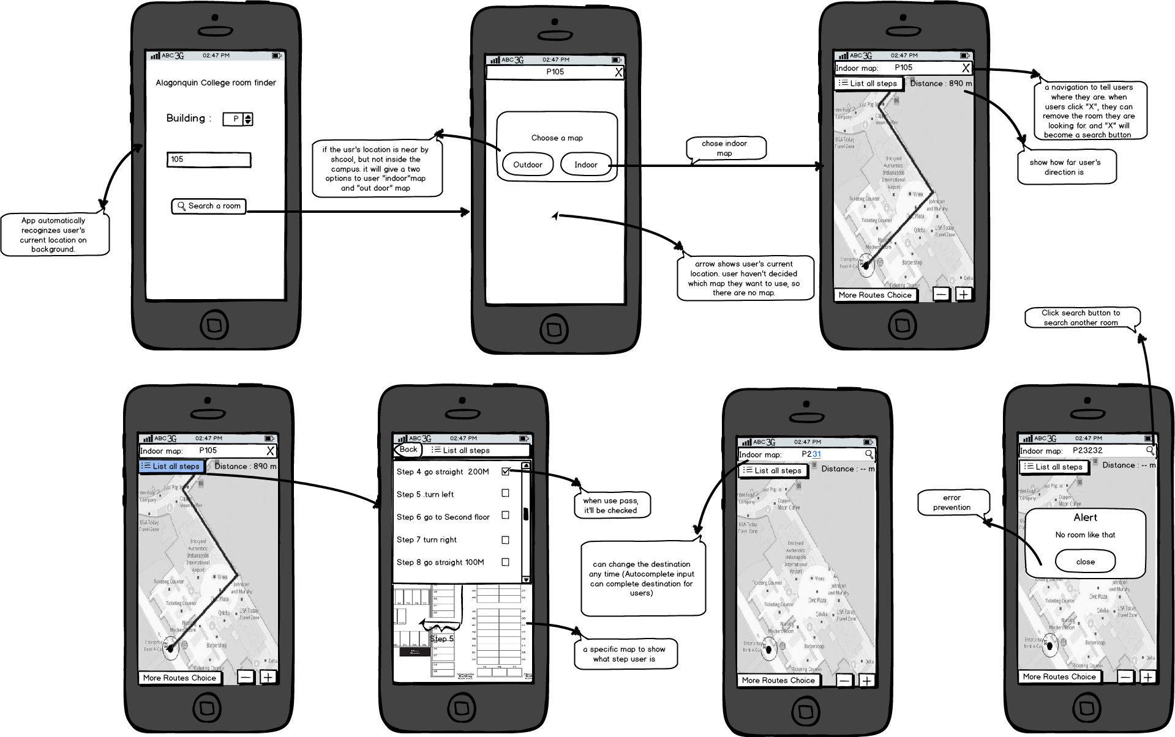
Wireframe For Jiana’s Scenario

Slide 9
Usage Scenario: Jiana’s fastest way from baseline to class (primary)
Tasks
Jiana uses her Android phone and launches the app
The app automatically recognizes that she is standing at Baseline station.
She inputs the destination as P105 in the app
It indicates that she would like to get the shortest possible way to her class
The app then shows her the directions and guides her towards the class
The app also shows her the landmarks that will come on her way
Selects options to use landmarks to guide her
Select the landmark near P building
Jiana gets the landmarks such as library and cafeteria.
Click the continue button to get to the class.
Context of use
Takes public transportation to get to the college.
Uses an HTC One phone with a 3G connection.
She haven’t make any friend at school.
English is not her first language and sometimes she struggles with it
Description
Jiana is new Algonquin student. She wants to find out how to get to her class on time on the second day of her class. She wants to use an app to find out fastest way to get to P105 from baseline since that’s where her class is. She wouldn't want to be late because she was late on her first day.

Slide 10
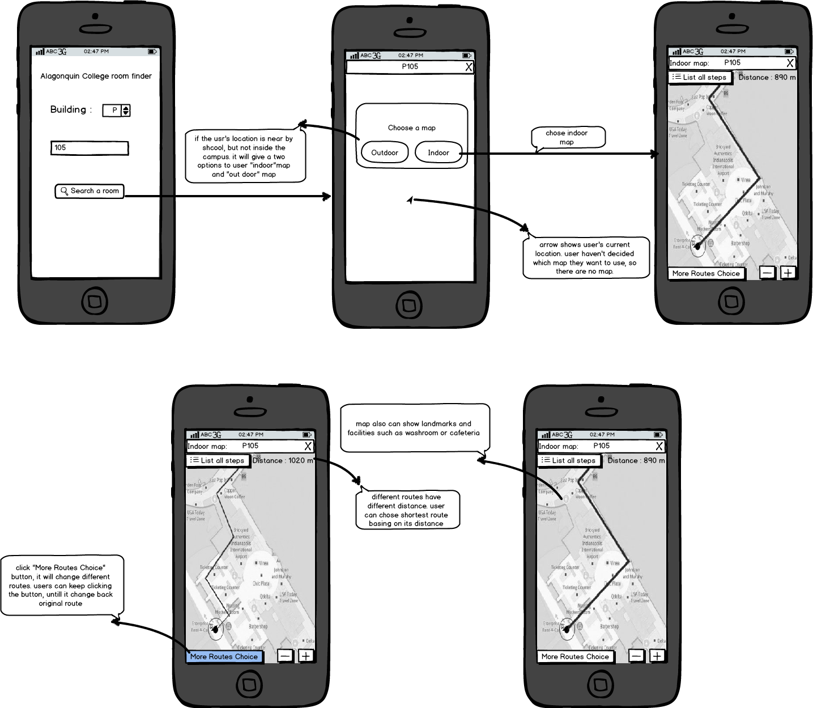
Wireframe For Jiana’s Scenario 2

Slide 11

Persona: Jagdish Information desk worker (secondary)
Goals and Attitudes:
Want to help people to find correct location
Ensure people can understand or memorize the direction
Ensure people don’t take detour
Support and encourage new students
Skills and Knowledge:
Can read and explain map
Proficiently use Google map or other map applications on phone
Good at oral explanation
Speaks English and Hindi
Excellent in assembling computers
“Helping people gives me real satisfaction ”
Context of use:
Sits at the help desk in front of library in A building
Has maps that he hand it out to new people who ask for helps
Uses app to show the directions easily
More than 20 people talk to him on daily basis
Need a better tool to reduce the line up
Description：
Age: 24
Name : Jagdish Katadiya
Student: Algonquin College
Program : Computer Technician
Nationality: Indian
Motivation：High
Like to meet new people
Have good patience
Like to help others
Tasks:
Use app to find a room in Algonquin
Make a mark on the map for others
Show others how to use the app to find a room

Slide 12
Usage Scenario: Jagdish is helping students by explaining directions (secondary)
Tasks
When student asked, he launches this app
The app automatically recognizes that he is inside school, so it displays a indoor map for him.
He enters the room number T-127
The map pins the room and show a blue route to him.
He shows the screen to the meghna
After he demonstrates the every intersection that this people need to turn, indoor map gives a intersection picture for him.
Based on those picture meghna can easily understand what Jagdish is saying.
She took picture from him and start following the steps
to get the class
Context of use
Uses school wireless connection on Nexus5
Uses Algonquin Live Chat to answer the student’s query
Needs to “zoom in” and “zoom out” so many times to guide the students
Description
Jagdish is working at Algonquin college help desk. He is tired to help people find his or her direction in campus because some directions are too hard to describe clearly. Some time he explain many times to a person, but Jagdish knows he or she will be lost. So he decide to use an App to help Meghna to find her class room T127

Slide 13
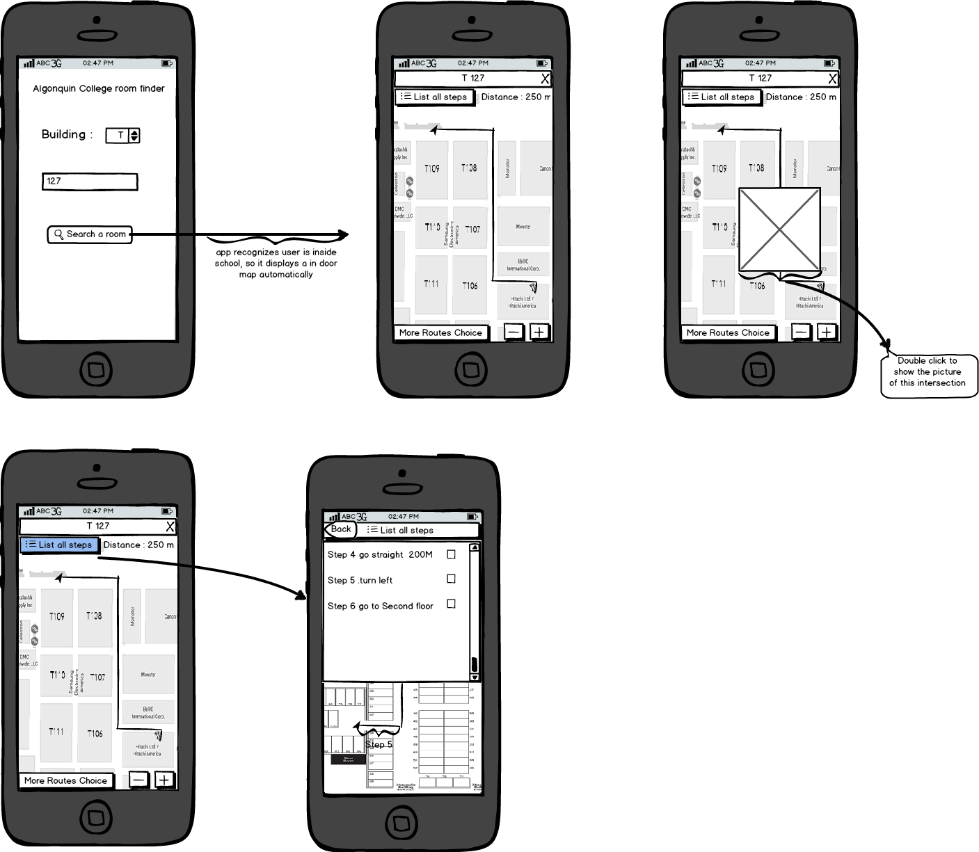
Wireframe For Jagdish’s Scenario

Slide 14
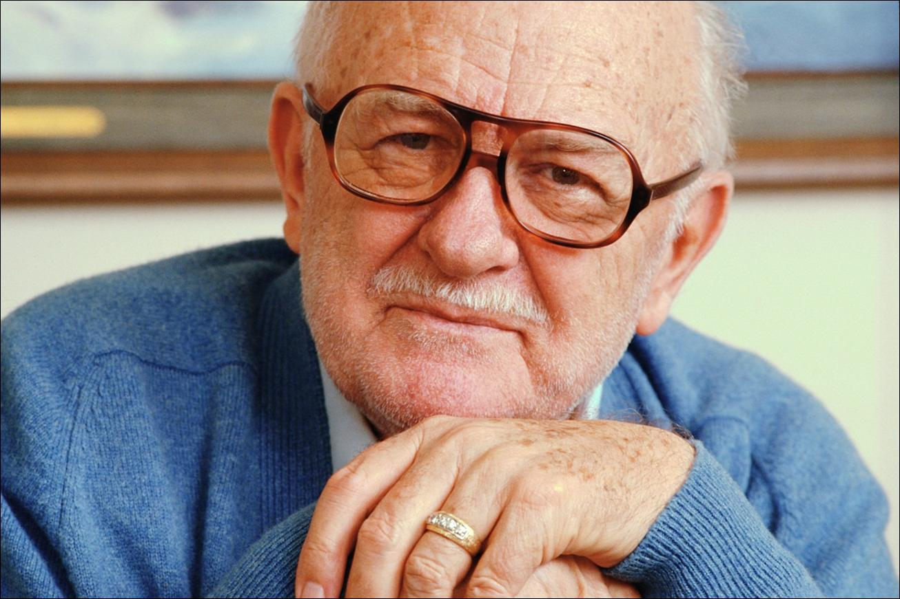
Persona: Bob Visitor (secondary)
Goals and Attitudes:
Want to find Algonquin theatre
Attend the event or meet friend on time
Don’t want to lost in Algonquin
Get there before the performance starts
Figure out where to park
Skills and Knowledge:
Speaks English, Spanish and
French
Good in reading maps
Have good computer skills
Know about business strategies
Good knowledge of MS-Word and Excel
Intermediate in using smartphone apps
“I hate getting lost”
Tasks:
Find their current location on a maps
Find the nearest parking lot
Find a nearest washroom or cafeteria in Algonquin
Description：
Motivation：Low
Name :Bob Martin
Age : 50
Nationality: Canadian
Education: University Of Ottawa
Work: JKS technologies(Owner)
Likes music and movies
Have Nexus 5 smartphone
Context of use:
Algonquin visit to attend event “Business Meet up”.
Drives to campus
Parks on campus
Uses maps from both at home and on campus
Uses 3G connection to access maps

Slide 15
Usage Scenario: Bob’s first visit in Algonquin college (secondary)
Tasks
Bob launches the app
The app automatically recognizes that he is not near by school, so it displays a outdoor map for him.
In app he enters the name E building and checks the outdoor maps for parking
He selects the nearest parking and entrance to take
After he arrived parking, he open the app again.
This time, app notices he is near by school, so it gives two option to him, “indoor” and “outdoor”, and he choose indoor.
On the indoor map, it displays all common facilities and blue route for him.
He enters the building and theatre that he wants to find
Finally, he easily found the theater, by using indoor map.
Description
Bob is new . He is going to attend a Algonquin college event at E building theater. He is not much familiar with Algonquin College. He knows the building name for the theater, but he don’t know where the nearest parking is for the theater. He decides to use an App to find it before leaving home, then he can choose an appropriate entrance
Context of use
Come to school by driving his car
Uses Samsung Galaxy4
Uses app in the car for navigation
Uses it when he walks

Slide 16
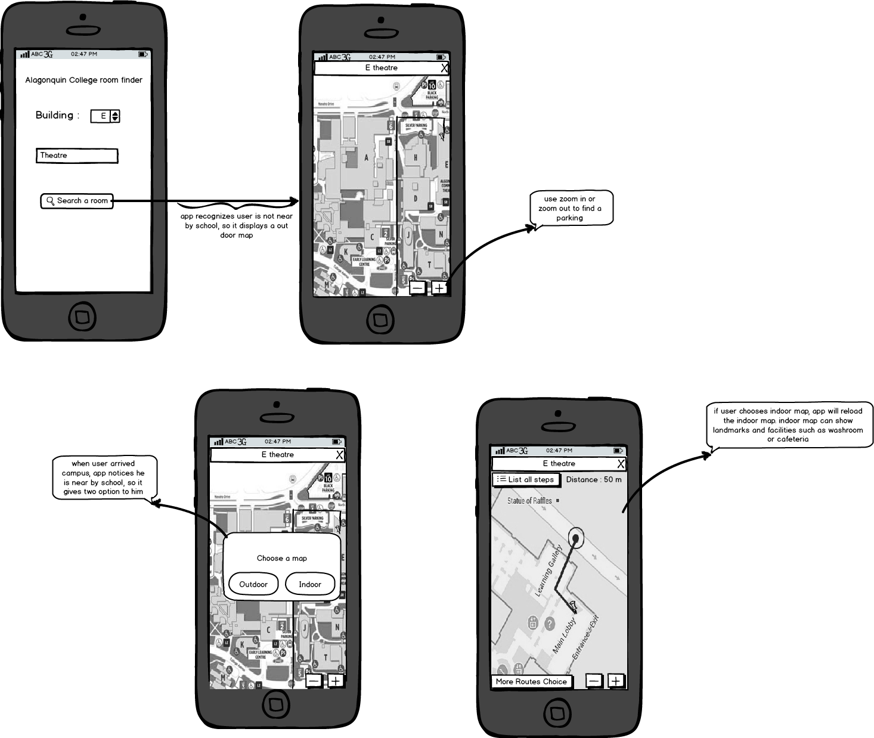
Wireframe For Bob’s Scenario

Slide 17
Key Decisions
I would say we have created this so for new people in Algonquin College. When they visit in Algonquin they don’t feel like lost they can use the app which is totally user friendly, they don’t have to struggle with paper map anymore. They can find the location by using our app it has functionality such as fastest route and works like a GPS and also give steps so user can easily find the location.

Slide 18
Thank you ☺ Questions??

